Slide 1

AI/ML BASED PROGRAMMING ON NANO–BIO INTERFACE
Haril , Anantha Teja , Srikar, Sravani, Pavani
UROP project
GROUP 3
Supervisor
Dr.Sabyasachi Chakrabortty
Associate Professor
Department of Chemistry
SRM AP Andhra Pradesh
B-Tech
Computer Science Engineering
SRM AP Andhra Pradesh
06-dec-2023

Slide 2
LIST OF CONTENTS
Introduction
Applications
Motivation
Methodology
Result and Discussion
Conclusion and Future plan
Acknowledgement

Slide 3
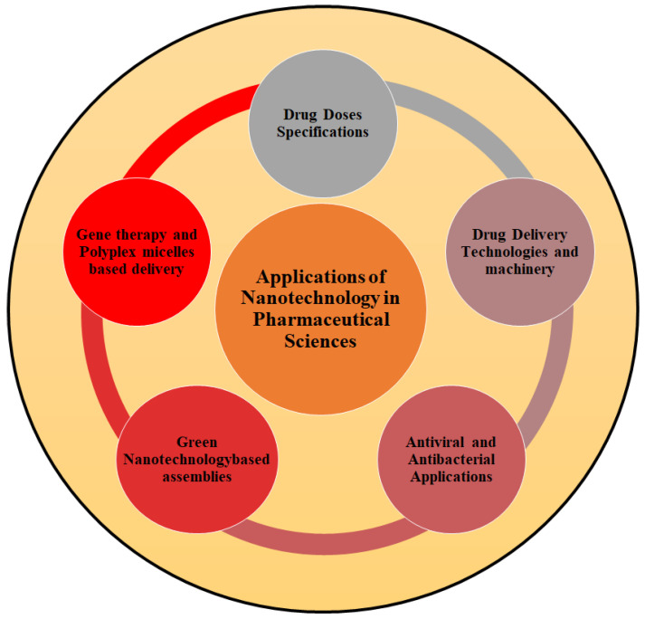
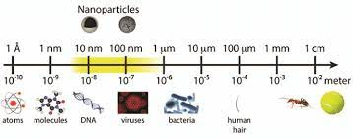
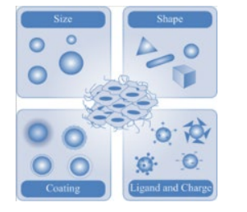
INTRODUCTION
Nanotechnology deals with the manipulation or engineering of matter on a near-atomic scale to produce new structures which are typically in the range of 1-100nm.
Nanotechnology for Advances in Medical Microbiology Springer(2021)
Surface to volume ratio
Size and shape
Unique optoelectronic properties that depends on size and shape
Challenges ??

Slide 4
MOTIVATION
Medical advancements like targeted drug delivery and diagnostics, needs the understanding of cellular interactions.
The motive behind research on nano-bio interfaces lies in harnessing nanotechnology to interact with biological systems for various applications.
Parameters that influence the Cellular uptake​
Size​
Shape​
Surface function group​

Slide 5
METHODOLOGY
Data Collection
Cellular uptake and Cytotoxicity data on nanoparticles' effects on HEK and HeLa cells.
Data Cleaning and Preprocessing
Handled missing values in some columns by filling them with empty strings.
User input and data filtering
Extracting Value and Unit from Cytotoxicity Values
The cytotoxicity values are extracted from the 'Cytotoxicity (mg/ml)' column using
regular expressions.​
Identifying nanoparticles with High toxicity values​
The code filters a DataFrame, groups it by unique nanomaterials, sorts each group based on cytotoxicity values and units in descending order.

Slide 6
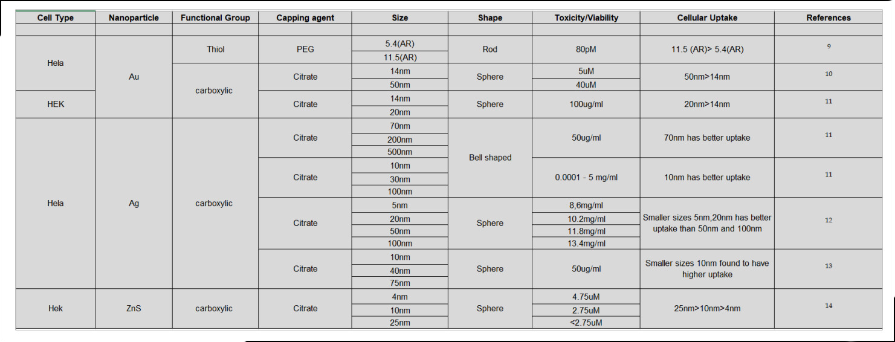
RESULT and DISCUSSION
Nanoparticle size with 20-50nm size found to have better uptake.

Slide 7
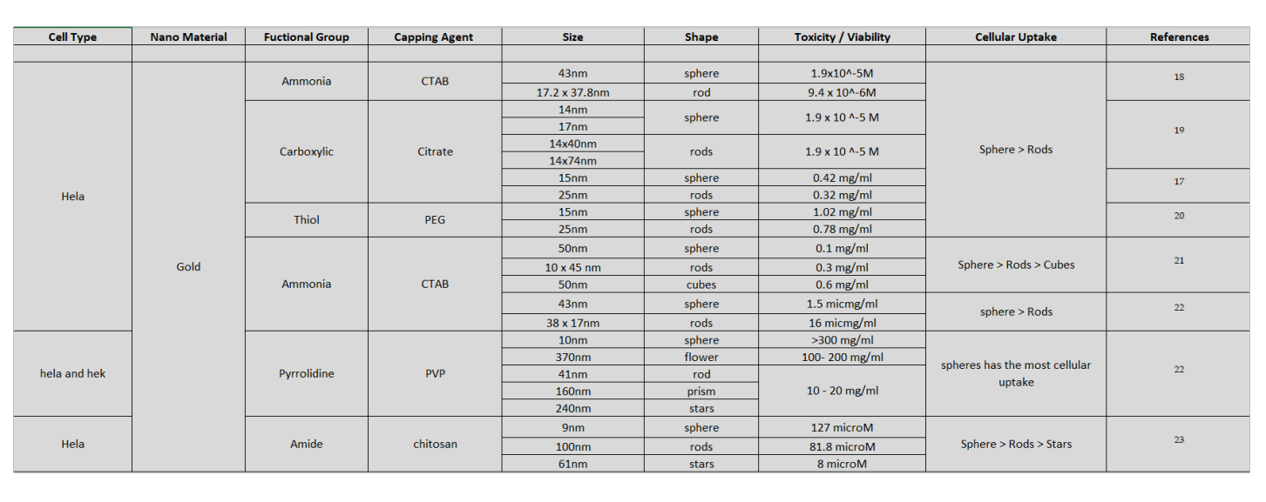
Sphere-shaped NPs have the maximum cellular uptake.

Slide 8
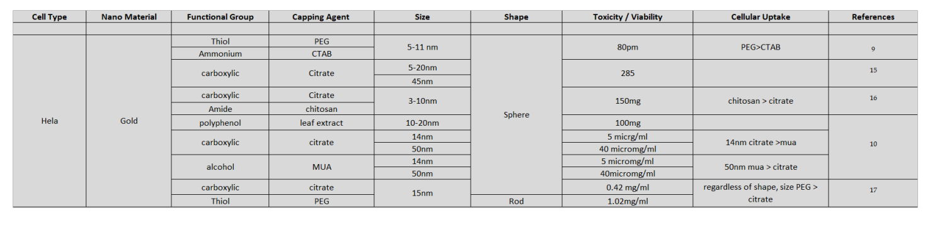
PEG-coated nanoparticles which have thiol as the functional group having the highest uptake compared.

Slide 9
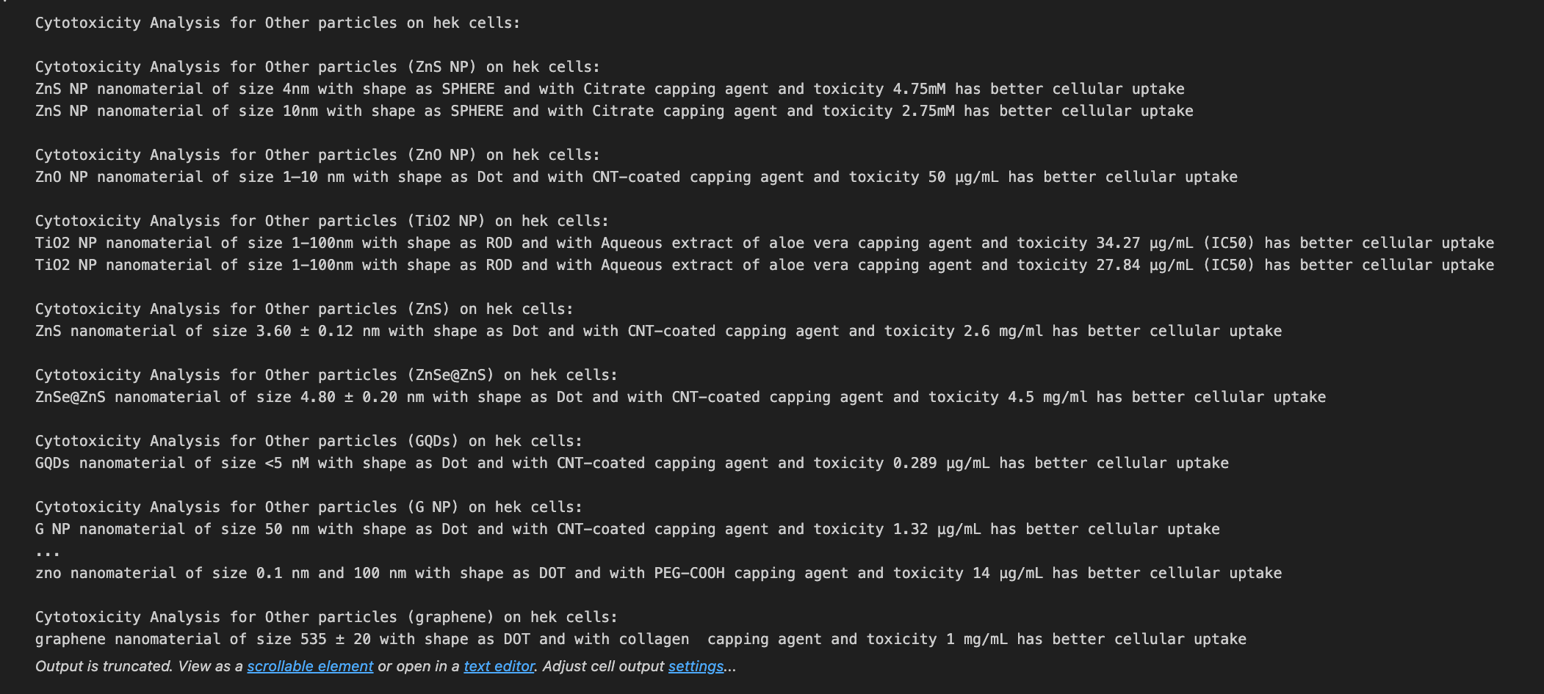
OUTPUT

Slide 10
CONCLUSION
Optimal Nanoparticle
Size: 20-50 nm for highest uptake efficiency via endocytosis.
Shape: Spherical nanoparticles outperform rods, cubes, and stars due to superior surface area.
Capping Agent: Thiol-functional agents like PEG-SH enhance uptake, with hydrophilic groups playing a role.
Ideal Combo: Spherical, 20-50 nm nanoparticles coated with PEG for efficient and targeted cellular uptake.

Slide 11
FUTURE PLAN
Nanomaterials show great potential in diverse biological and industrial applications, but their unique physicochemical characteristics raise concerns about potential environmental and human health effects. Future research should consider additional factors like surface charge, hydrophobicity/hydrophilicity, temperature, incubation time, steric hindrance, nanoparticle preparation methods, and solution properties to comprehensively understand cellular uptake.

Slide 12
ACKNOWLEDGEMENT
In concluding our research on "Nano-Bio Interface using AI/ML," I express sincere gratitude to each team member for their dedicated efforts throughout our collaborative journey. Your commitment and expertise played a pivotal role in navigating the complexities of nanoparticle uptake. I appreciate the meticulous data analysis, experimental skills, insightful discussions, and critical thinking that enhanced our interpretations. Special recognition goes to Dr. Sabyasachi Chakrabortty and Shamili Bandaru for their valuable contributions. Let's reflect on the significance of our findings, celebrate our achievements, and anticipate the impact of our research on advancing nanoparticle interactions. Thank you all for your hard work, passion, and collaborative spirit in contributing to the scientific community.

Slide 13


